Slide 1


EPICS REVIEW 2024
Problem Statement Title: Enhancing Fire Safety in Public Spaces, Industrial Automation
Idea Title : Semi –Automated Fire Extinguisher using IoT
Team Name: Techtronz
Theme: Promoting Safety and Security Through Advanced Technology Solutions

Slide 2
Team Details
Team Name: Tech Savant
College Name: Karpagam Institute of Technology
NethajiNaveenPrasath. S Male III-ECE 7603900791 21ecb01@karpagamtech.ac.in
Nithish kumar A Male III-ECE 9345567019 21ecb03@karpagamtech.ac.in
Sivabalvigneshan P Male III-ECE 6380541839 21ecb34@karpagamtech.ac.in
Vishal S Male III –ECE 8799595404 21ecb57@karpagamtech.ac.in

Slide 3
Problem Description
In recent years, the occurrence of fire accidents in public places such as malls and airports has raised significant concerns regarding safety standards and emergency preparedness.
The consequences are dire, resulting in potential loss of life, injuries, property damage, and disruptions to critical services..
Proactive efforts in these areas are essential to safeguarding the well-being of individuals and maintaining the integrity of public spaces.

Slide 4
Your Idea
To address the fire safety concerns in public places like malls and airports, we propose leveraging advanced technology such as the ESP32 microcontroller along with flame and smoke sensors. By integrating these components into the existing infrastructure, we can establish a proactive fire detection and prevention system
The ESP32 microcontroller serves as the central processing unit, capable of efficiently managing data from various sensors in real-time. Flame sensors can detect the presence of flames, while smoke sensors can identify the early signs of smoke, both crucial indicators of potential fire hazards.
Upon detecting abnormal readings from the sensors, the ESP32 can trigger immediate responses, such as activating alarms, notifying authorities, and initiating automated fire suppression systems. Additionally, the system can facilitate rapid communication with building occupants, providing clear evacuation instructions and guiding them to safety.

Slide 5
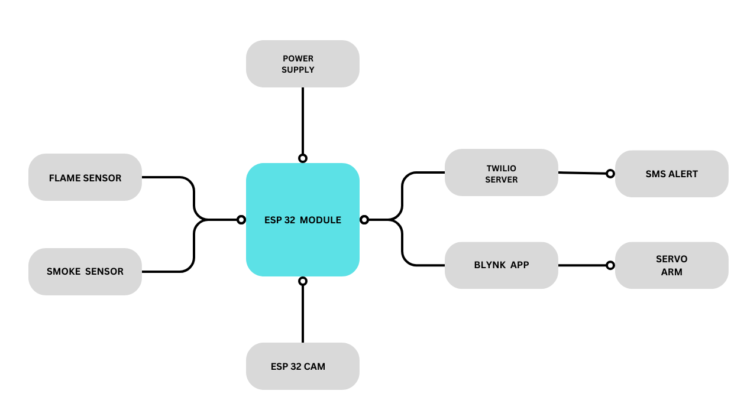
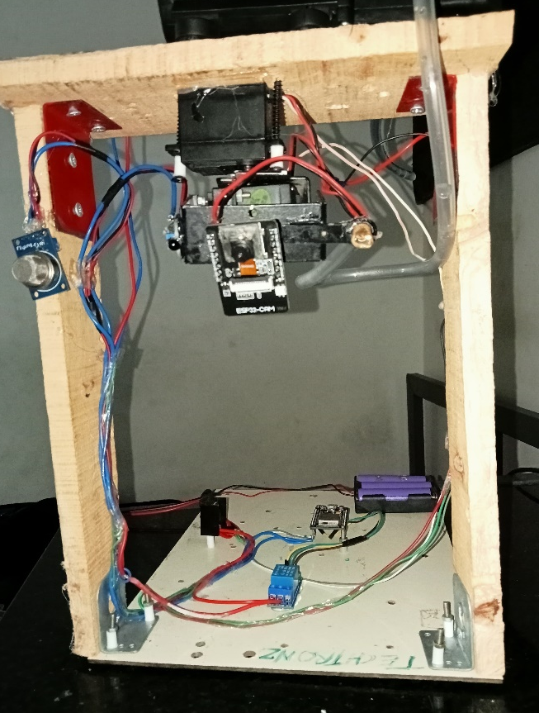
Pictorial Representation of the Idea

Slide 6
Technology Stack
IOT
Cloud communications

Slide 7


Demo/Output
-----BLYNK CONSOLE
TWILIO WEB SERVER-----

Slide 8
Social Benefits
Enhanced Public Safety: By promptly detecting fire hazards and initiating appropriate responses, such as activating alarms and guiding occupants to safety, the system significantly reduces the risk of injuries and fatalities in the event of a fire
Protection of Lives and Property: Early detection allows for timely evacuation and containment measures, preventing the spread of fire and reducing its impact on infrastructure and belongings.
Improved Emergency Response: The system facilitates efficient communication with emergency responders, providing real-time information about the location and severity of the fire.
Accessibility and Inclusivity: Public spaces equipped with advanced fire safety systems ensure accessibility and inclusivity for all individuals, including those with disabilities or mobility impairments.

Slide 9
Commercial Viability
.
Risk Mitigation : Investing in advanced fire detection and prevention systems helps mitigate these risks by minimizing the likelihood and severity of fire incidents, thereby safeguarding assets and interests.
Cost Savings: While the initial investment in deploying a fire detection and prevention system may be substantial, the long-term cost savings outweigh the upfront expenses.
Scalability and Adaptability: The modular nature of the ESP32 microcontroller platform allows for scalability and adaptability to various environments and applications
Value-added Services: Beyond basic fire detection and prevention capabilities, the system can offer value-added services such as real-time monitoring, predictive maintenance, and customer satisfaction.
Overall, the total project cost is estimated to range from Rs.10,000 to Rs.12,000, depending on factors such as project scope, complexity, and location.

Slide 10
Conclusion
In conclusion, the implementation of a fire detection and prevention system leveraging ESP32 microcontrollers and advanced sensors in public spaces like malls and airports offers a compelling solution to enhance safety, mitigate risks, and protect lives and property.
By harnessing innovative technology, the system provides proactive detection of fire hazards, swift response capabilities, and seamless integration with existing infrastructure.
With its scalability, adaptability, and potential for value-added services, the project presents a commercially viable opportunity to meet the growing demand for advanced fire safety solutions and contribute to creating safer environments for communities and businesses alike.

